Slide 1

| Concept of Artificial Intelligence
Ethical implications
of developing new intelligence
- Abdan Hafidz (5054231 021)
- Dhafin Kurniawan (5054231 0)
- Khairiah Michiko W (5054231 028)

Slide 2

A.I as a Great Transformer
Artificial Intelligence (AI) has rapidly advanced in recent years, transforming various aspects of our lives.
From autonomous vehicles to personalized shopping recommendations, AI is shaping the way we work, communicate, and even think. However, with great technological power comes great responsibility, and the ethical implications of AI are a critical concern in the digital age. This essay explores the ethical challenges posed by AI and the imperative for society to navigate a moral compass in this brave new world.

Slide 3

AI's Potential and Perils
AI offers unparalleled potential for improving efficiency, making decisions based on data-driven insights, and addressing complex societal issues.

Slide 4
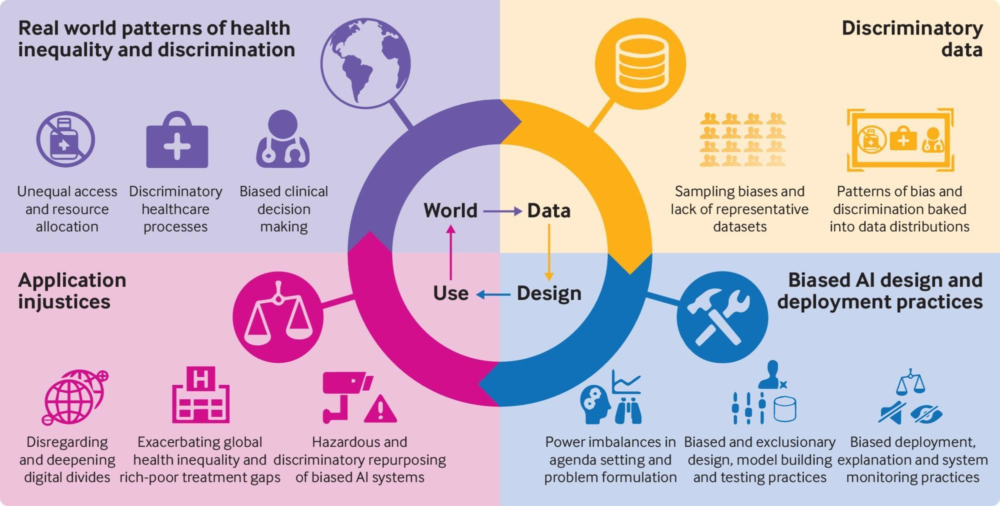
AI's Potential and Perils
Yet, its rapid deployment raises a host of ethical concerns:
Bias and Discrimation
AI algorithms can inadvertently perpetuate and amplify human biases present in training data. This can lead to discrimination in areas like hiring, lending, and law enforcement.

Slide 5
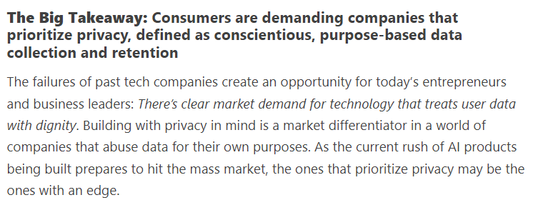
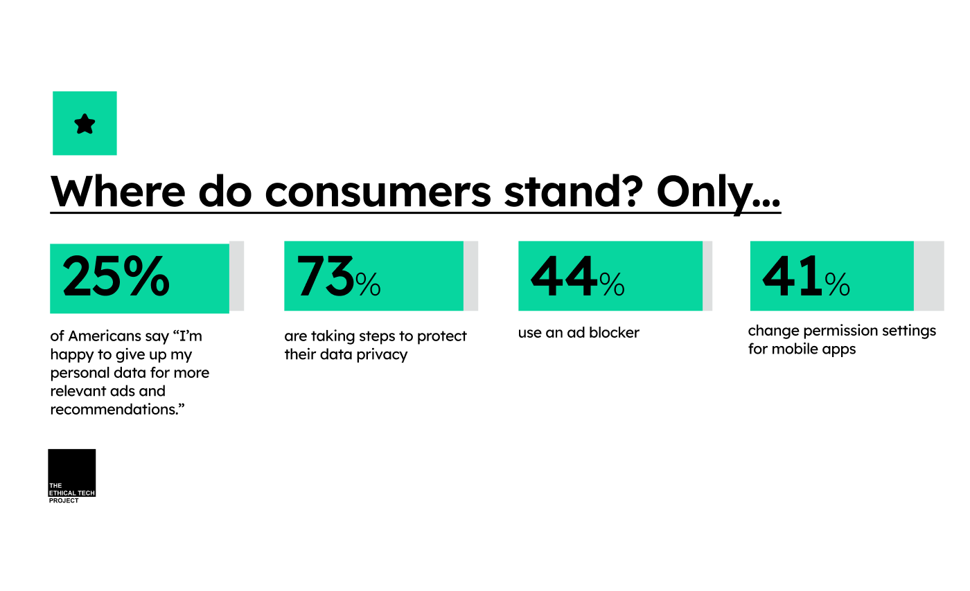
AI's Potential and Perils
Yet, its rapid deployment raises a host of ethical concerns:
2) Privacy
AI can process and analyze vast amounts of personal data, potentially infringing on individual privacy. The rise of facial recognition technology has ignited debates about the right to privacy in public spaces..

Slide 6

AI's Potential and Perils
Yet, its rapid deployment raises a host of ethical concerns:
3) Autonomy and Accountability
As AI systems gain autonomy, questions of responsibility and accountability emerge. Who is liable when an autonomous vehicle crashes, or a medical diagnosis goes awry due to an AI recommendation?

Slide 7
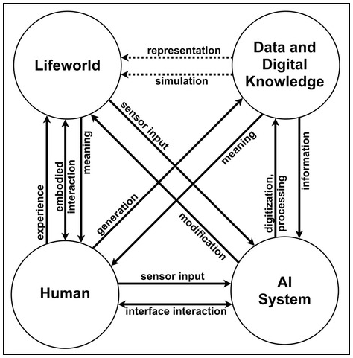
AI's Potential and Perils
Yet, its rapid deployment raises a host of ethical concerns:
3) Autonomy and Accountability

Slide 8

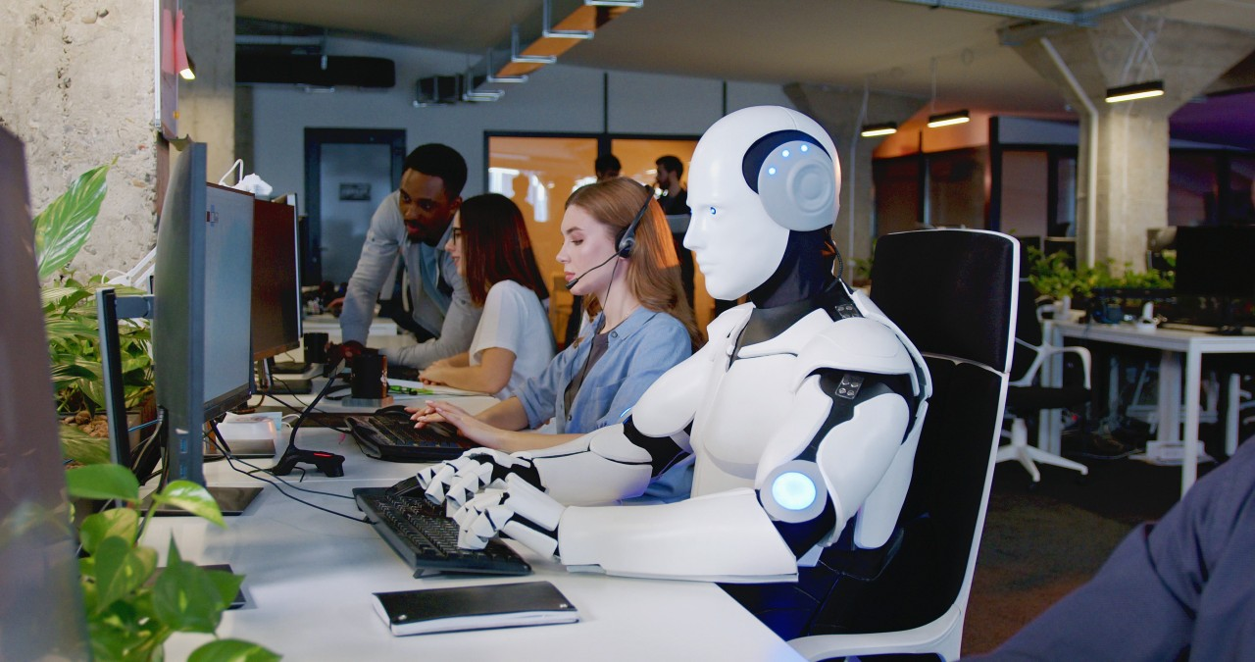
AI's Potential and Perils
Yet, its rapid deployment raises a host of ethical concerns:
4) Job Displacement
How many jobs will be lost to ai by 2025? The World Economic Forum has estimated that artificial intelligence will replace some 85 million jobs by 2025

Slide 9

AI's Potential and Perils
Yet, its rapid deployment raises a host of ethical concerns:
4) Job Displacement
Automation driven by AI can lead to job displacement and economic disruption. The ethical challenge lies in managing these transitions and ensuring that individuals are not left behind.

Slide 10
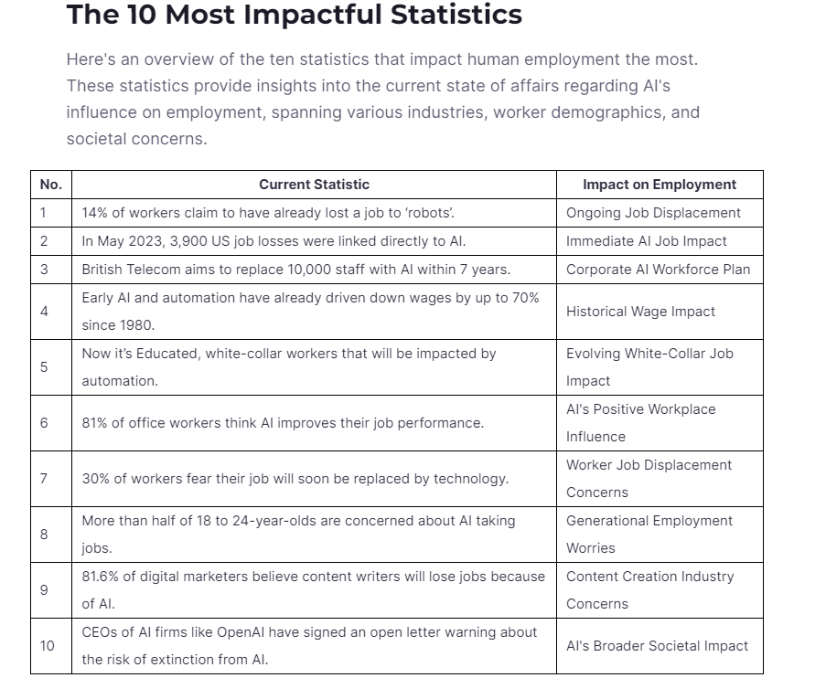
AI's Potential and Perils
Yet, its rapid deployment raises a host of ethical concerns:
4) Job Displacement

Slide 11
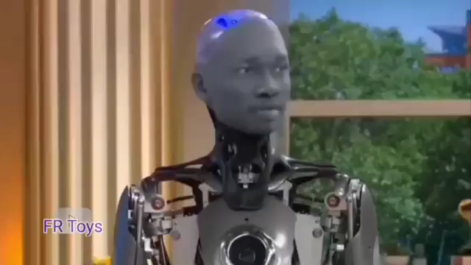
AI's Potential and Perils
Yet, its rapid deployment raises a host of ethical concerns:
5) Moral Decision-Making
AI might have to make moral decisions in scenarios like self-driving car dilemmas. Deciding how AI should navigate such ethical dilemmas is a profound challenge.

Slide 12
Navigating the Ethical Maze
To navigate the ethical maze of AI, several strategies are crucial
1. Transparency : Developers and organizations must be transparent about the data sources and algorithms they use, enabling oversight and accountability.
2. Diverse Representation : The AI community should prioritize diversity in its workforce to mitigate bias in algorithms and enhance ethical decision-making.
3. Ethical Frameworks : Developing and implementing ethical frameworks and guidelines for AI development and deployment is essential.
4. Regulation : Governments and regulatory bodies must enact and enforce laws to protect privacy, guard against discrimination, and ensure accountability.
5. Education and Awareness : Raising public awareness and educating individuals about AI's ethical implications will empower society to make informed decisions.

Slide 13
The Human-AI Partnership
Rather than fearing or rejecting AI
society should aim for a harmonious human-AI partnership. This partnership involves using AI as a tool that complements human capabilities, allowing us to make more informed decisions and solve complex problems. Furthermore, it necessitates human intervention in AI processes to ensure ethical conduct.

Slide 14
Contemplation
The rise of AI represents one of the most significant technological advancements in human history
with the potential to revolutionize countless aspects of our lives. However, the ethical challenges it poses cannot be ignored. Navigating the ethical implications of AI is not a solitary endeavor but a collective responsibility that involves governments, corporations, developers, and individuals. By fostering transparency, diversity, and ethical guidelines, we can steer AI toward a future that respects our values and aligns with our moral compass in this increasingly digital age. The ethical considerations surrounding AI are, and will continue to be, a defining aspect of our technological journey.

Slide 15
Thanks ☺
Refferences :
https://www.firstgulfsolutions.com/
https://seo.ai/blog/
https://www.nexford.edu/insights/

